Slide 1
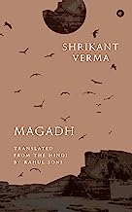
College Library,
Goswami Ganesh Dutta
Sanatan Dharma College, Chandigarh
Books of the Month
August 2023

